Slide 1


Assignment - NSE Alliance – I & CPM
Harsh Wardhan Singh
Notes:
Photo by CoWomenon Unsplash

Slide 2
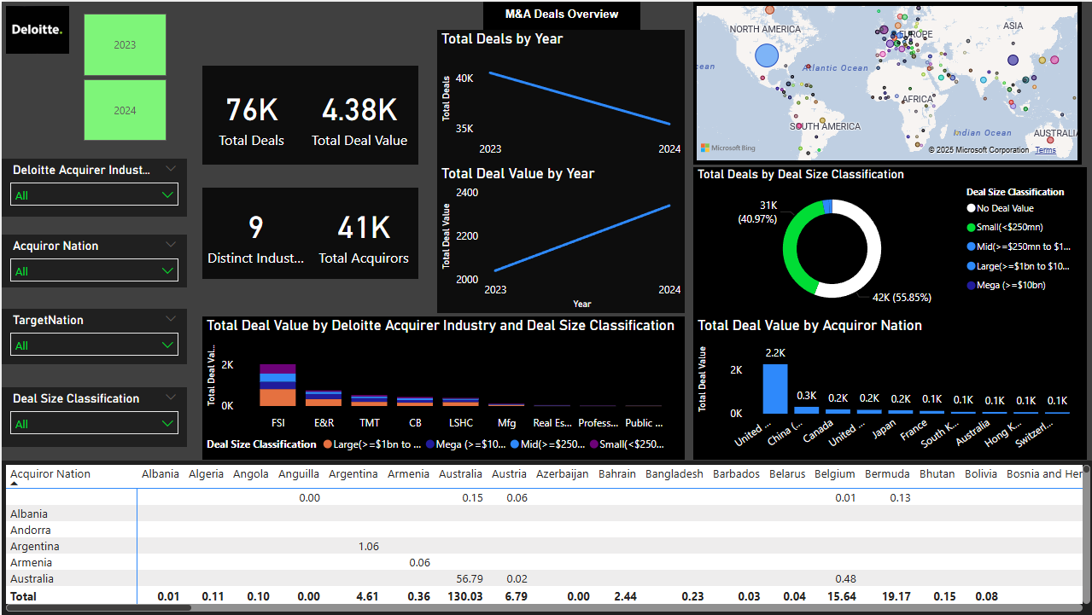
Geographic Insights
The United States leads both as an acquirer and target nation, accounting for the highest volume of M&A activity.
China (Mainland), Japan, and the United Kingdom follow as the next most active acquirers.
As target nations, China, the UK, Japan, and Canada also feature prominently, indicating strong bilateral deal flows among major economies.
Notes:
Photo by The Coach Space from Pexels

Slide 3
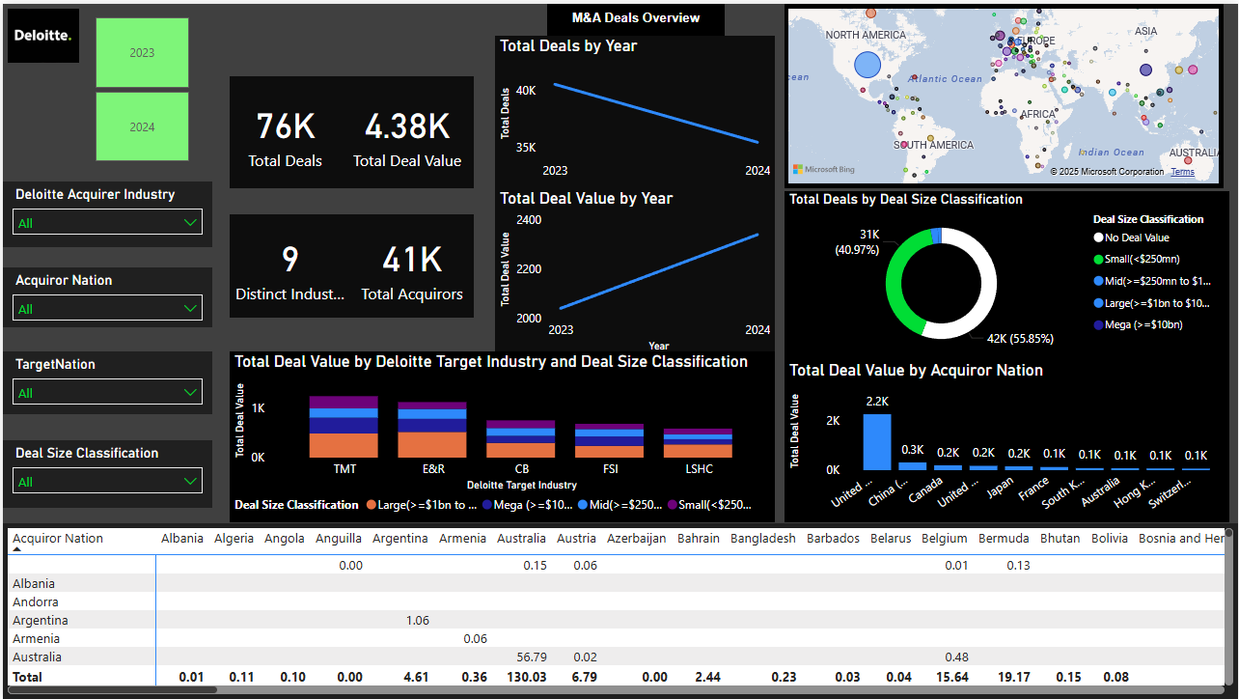
Industry Insights
The most active sectors for acquisition include:
TMT
E&R
CB
FSI
Total Deal Value increased by 14.67%, indicating stronger capital deployment and a possible shift toward higher-value transactions.
Despite this growth in value, the total number of deals declined by 12.47%, suggesting a more selective M&A environment where fewer, but larger or more strategic, deals are being executed.
Notes:
Photo by The Coach Space from Pexels

Slide 4
Deal Size Distribution
A majority of deals were either small (<$250 million) or had undisclosed values.
Only a small fraction of deals were classified as mid-sized or large, with just 52 mega-deals (> $10 billion) recorded across the two years..
This indicates that the M&A market remains fragmented, with a high volume of strategic or niche acquisitions rather than blockbuster transactions..
Notes:
Photo by The Coach Space from Pexels

Slide 5
Deal Volume Trends
M&A activity declined in 2024, with 35,485 deals, down from 40,541 in 2023..
The drop may reflect broader macroeconomic caution or sector-specific slowdowns in key markets.
Notes:
Photo by The Coach Space from Pexels

Slide 6
Conclusion
The M&A landscape is dominated by major economies, particularly the U.S. and China, with financial services and technology sectors leading acquisition activity.
While deal counts remain high, most transactions are small-scale or undisclosed, highlighting a shift toward targeted, strategic M&A rather than high-value consolidation plays.
The slight decline in 2024 deal volume may warrant closer observation in future periods.
Notes:
Photo by The Coach Space from Pexels

Slide 7

Thank You
Notes:
Photo by Charles Forerunneron Unsplash

